Slide 1
Web Test Automation Idea & Implementation thru Katalon Studio
June 2019

Slide 2
Contents
Problem Statement
Requirement in Nutshell
Solution & Justification
Implementation Snap Shots
Target Achieved
POC Details

Slide 3
Problem Statement
Client System
Highly Complex Policy Admin System – A Web Application
Business Worth
Handles 0.5 million Policy Contracts worth of Billion Dollars
Problems
High Viscosity between application layers ( Tightly Coupled Modules/Layer)
High Impact Level even for small change in System
Tedious to achieve 100% Regression Scope
Testing period spans 3 weeks which is >= Development Time
Developers are unable to identify issue earlier
Lack of Agility in Development, QA & Delivery
Impact
Leads to Drop in Quality & Logistics in Deliverables

Slide 4


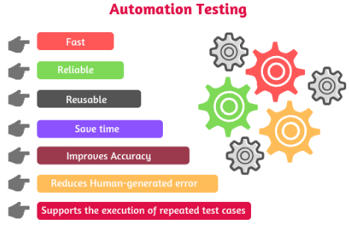
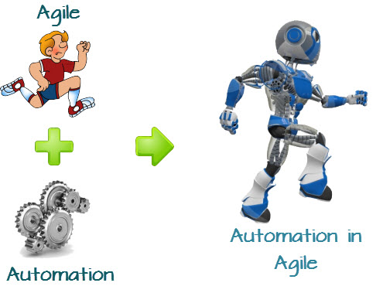

Slide 5





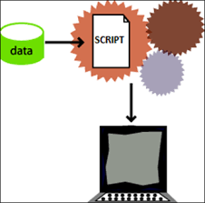
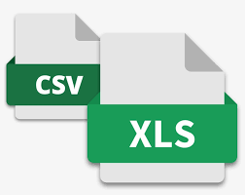

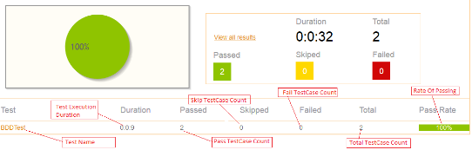




Solution & Justification
Solution
Regression through Web Automation Testing
Katalon Studio - A Web Automation Tool Identified for Implementation
Justification
Katalon Studio Fulfills all of our requirements depicted below
0% Coding Effort & Easy to set up
Resources with 0% Programming Skills
Fastest & Scalable Test Case Preparation
Data Driven
Email Notification
Regression Test Case Reporting
Integration

Slide 6

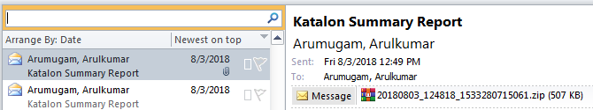
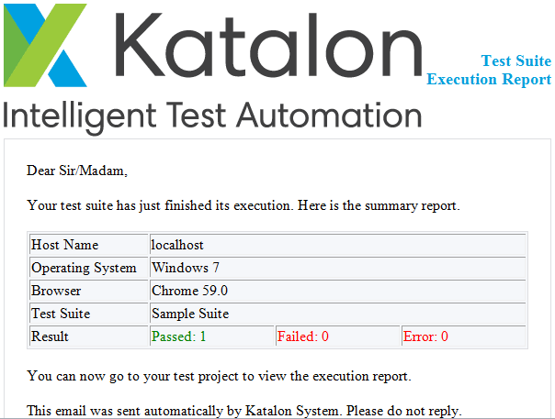
Implementation Snap Shots
Email Notification

Slide 7

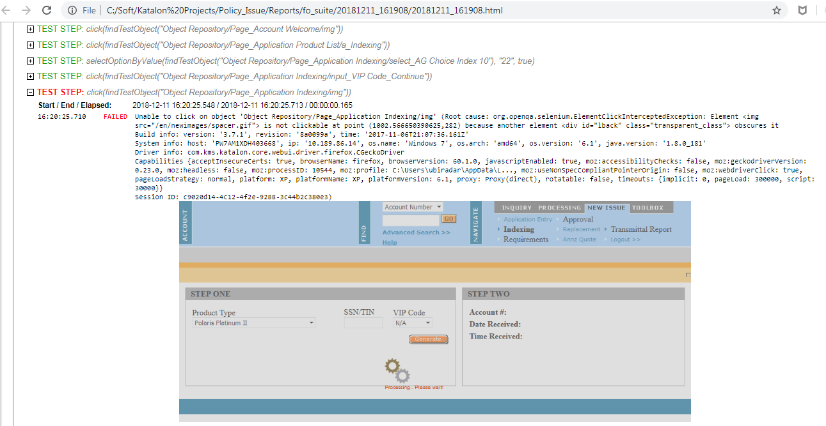
Implementation Snap Shots
Failure Test Case Screen Shot

Slide 8
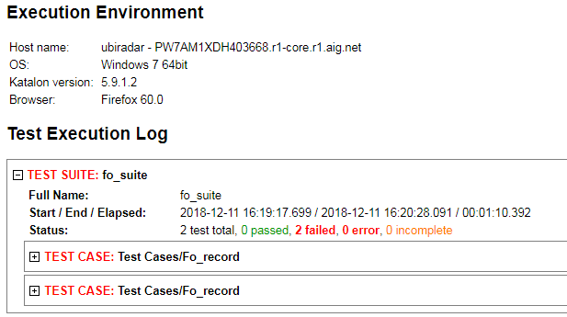
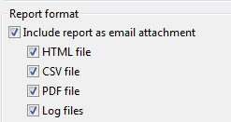
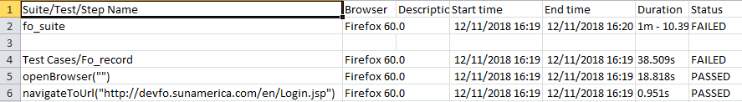
Implementation Snap Shots
Test Case Reports & Various Formats
HTML Report
Report Formats
Excel Report

Slide 9
Target Achieved
Our Target
Gain Business Value in terms of Quality, Time & Cost by resolving all our issues mentioned in problem statement due to traditional regression testing.
Gained thru Katalon Studio
Quicker Test Case Preparation
Reusability of Test Cases
Regression made simple & Data Driven with 99% scope
Automated Reporting
Automated Email Notification
Issues are identified before it reaches to QA environment
Agility due to Integration feature with GitHub, Jenkins & JIRA
Target Achieved
Gained Business Value thru Katalon Studio Automated Regression for 1 Lakh policies quickly .
Time taken reduced to 1 day from 1 week by Automation
Cost by 0% coding & 0% Programming skill
Quality by earlier identification of Issues (Agility

Slide 10
POC Detail
Test Case Running Video

Slide 11
THANK YOU

Slide 12
This Video Contains
POC – Web Automated Regression Testing by Katalon Studio
Steps to create using Katalon Studio
Creating Regression Testing Project using Katalon Studio
Benefits Achieved
Nearly 1 lakh policies are processed with 100s of Test Case Scenarios using this.
Below are the benefits we have achieved thru this.
0% Coding Effort
Resources with 0% Programming Skills
Fastest Test Case Preparation
Data Driven
Email Notification
Regression Test Case Reporting
Integration

